Slide 1

BC2410, Prescriptive Analytics From Data to Decisions
Lecture 11

Slide 2
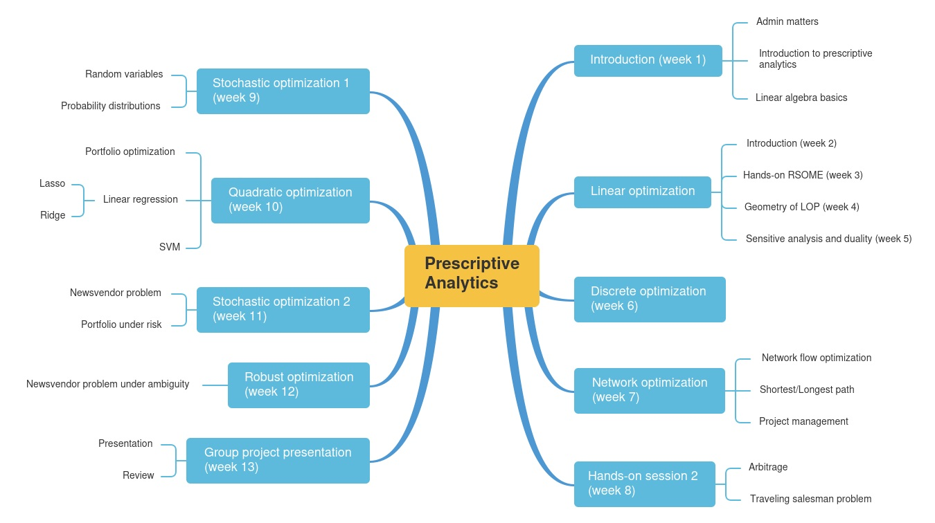
Schedule

Slide 3
Schedule

Slide 4
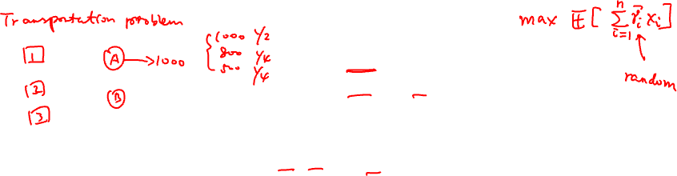
Optimization under Uncertainty
Parameters of the model c, A, and b may be uncertain when decision x is made
How would one describe uncertainty?
How would one evaluate the “best” solution under uncertainty?

Slide 5
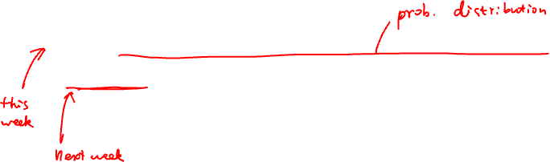
Facets of Uncertainty
Risk: Uncertainty with known frequency of occurrence
Ambiguity: Uncertainty without known frequency of occurrence
Also known as Knightian uncertainty, due to economist Frank Knight (1885-1972)

Slide 6
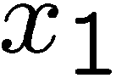

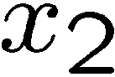

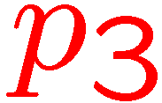
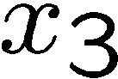

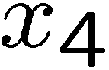
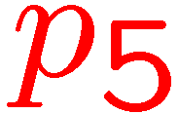
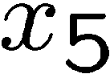
Facets of Uncertainty: Risk
Uncertainty described via Random Variables
Widely accepted method in math/statistics
Characterized by
Sample space (all possible outcomes, usually exponential or infinite)
Distributions (probability of outcome)
Optimize via Stochastic Programming

Slide 7
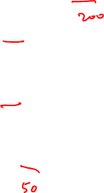
Decisions Under Risk
$20M
A is preferred in decision tree.
Why?
0.5
A
0.5
B
$0
$5 M

Slide 8
Stochastic Programming
An approach of optimization under risk
Optimization that is based on a collection of uncertain outcomes
Historical data
Generated by Monte Carlo Simulation

Slide 9
Xiao Long Bao’s Problem
Due to the outbreak of COVID-19, many students chose not to have their lunch or dinner at South Canteen. The cook of Xiao Long Bao didn’t know how many Mala Beef La Mian to prepare, so he collected some lunch data for the first week:
How many MBLM to prepare before the lunch time?
 | # of MBLM sold
Mon | 3
Tue | 7
Wed | 4
Thu | 6
Fri | 5

Slide 10
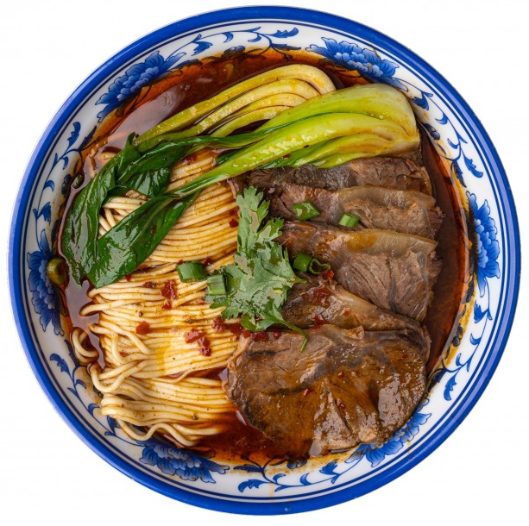
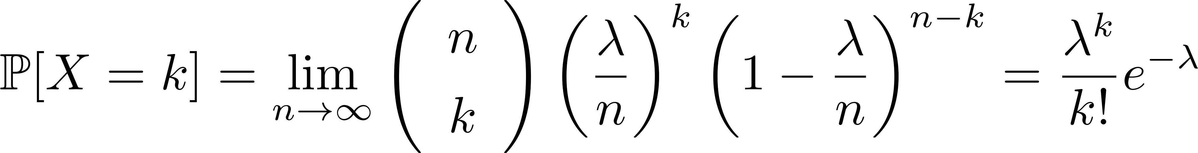
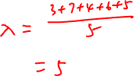
Xiao Long Bao’s Problem
 | # of MBLM sold
Mon | 3
Tue | 7
Wed | 4
Thu | 6
Fri | 5
11:00
14:00
T

Slide 11
A Newsvendor Problem
Buy x items at cost c
Items sold at price p
Salvage price is zero
Uncertain demand, hence profit is uncertain

Slide 12

Summary

Slide 13
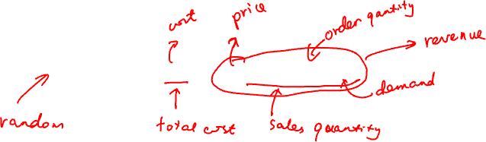
A Newsvendor Problem
Buy x items at cost c
Items sold at price p
Salvage price is zero
Uncertain demand, hence profit is uncertain

Slide 14
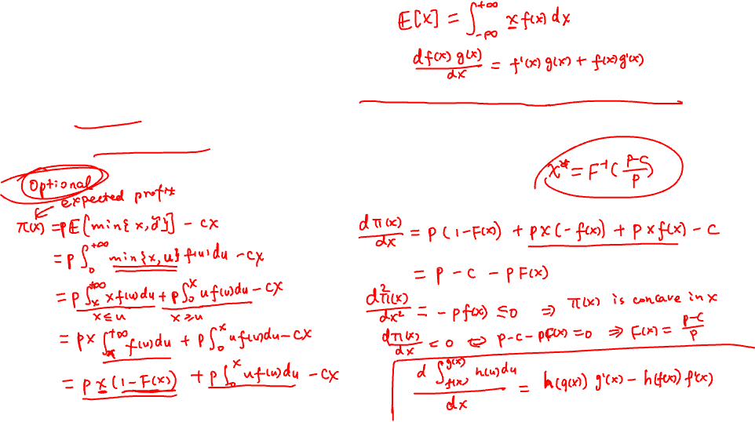
A Newsvendor Problem
Assume that the process can be repeated indefinitely under identical conditions justify one to maximize expected profit
Closed form solution available.

Slide 15
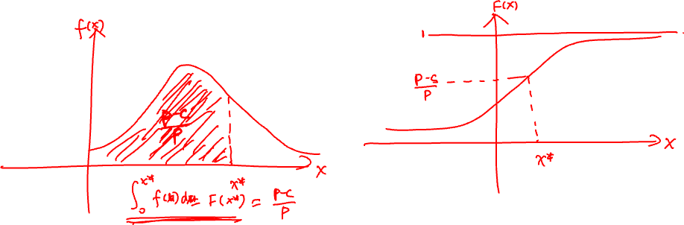
A Newsvendor Problem
Assume that the process can be repeated indefinitely under identical conditions justify one to maximize expected profit
Closed form solution available.
We can solve a stochastic programming problem by generating data using Monte Carlo simulation.

Slide 16
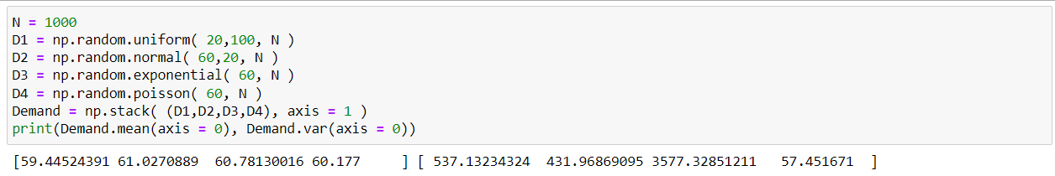
Generate Demand

Slide 17
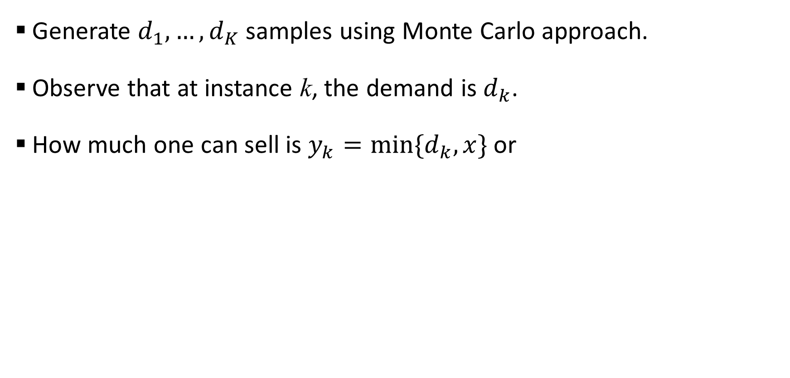
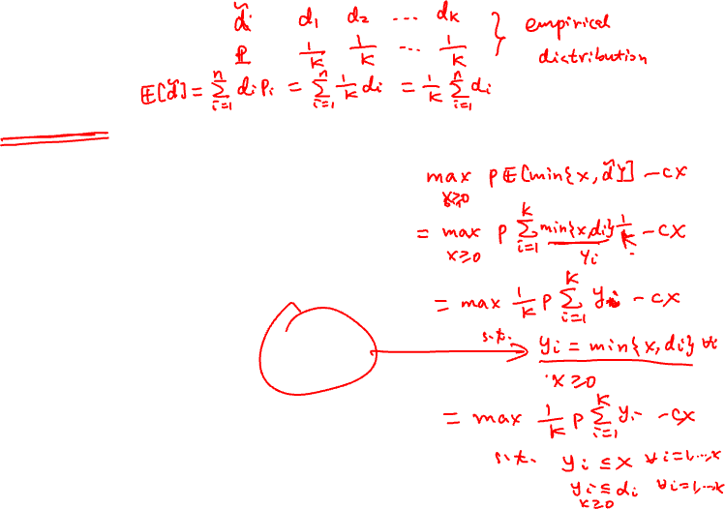
A Newsvendor Problem
Generate $d_{1}, …, d_{K}$ samples using Monte Carlo approach.
Observe that at instance k, the demand is $d_{k}$.
How much one can sell is $y_{k}=min⁡\{d_{k}, x\}$ or

Slide 18
A Newsvendor Problem
Sampling Average Approximation (SAA) of the Newsvendor problem.
Quality of the solution improves with the number of samples.

Slide 19
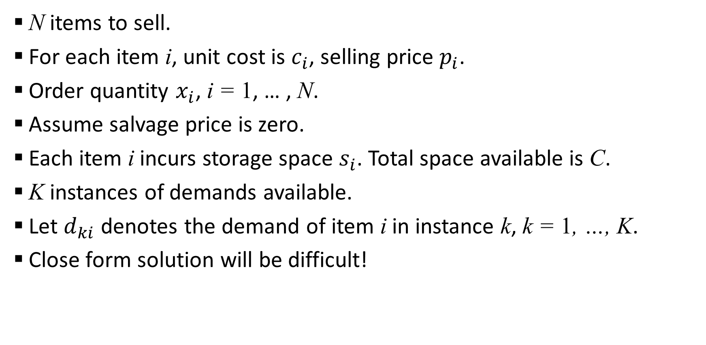
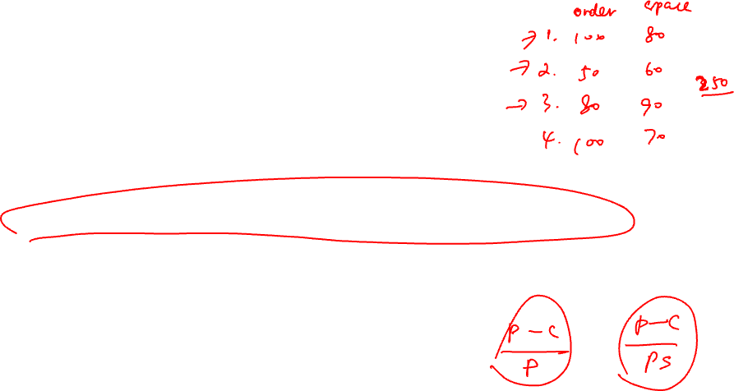
Multi Product Newsvendor Problem
N items to sell.
For each item i, unit cost is $c_{i}$, selling price $p_{i}$.
Order quantity $x_{i}$, i = 1, … , N.
Assume salvage price is zero.
Each item i incurs storage space $s_{i}$. Total space available is C.
K instances of demands available.
Let $d_{ki}$ denotes the demand of item i in instance k, k = 1, …, K.
Close form solution will be difficult!

Slide 20
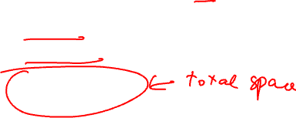
Multi Product Newsvendor Problem

Slide 21


A Two Stage Stochastic Program
First stage
Second stage

Slide 22
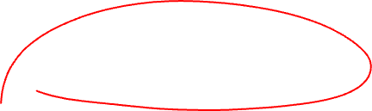
A Two Stage Stochastic Program
Formulation can be very large.
Sometimes solutions could be difficult to obtain.

Slide 23
Decisions Under Risk
$20M
Suppose you play the game once, which one would you choose?
0.5
A
0.5
B
$0
$5 M

